Slide 1





AGRICULTURAL RAW MATERIAL ANALYSIS
STUDENT DETAILS:
NAME: MP RUBASREE (UR NAME)
NM ID: au2021111068
081C0D4187D87EC8B054262E96EB37F1 (UR ID)
COLLEGE NAME: COLLEGE OF ENGINEERING GUINDY, ANNA UNIVERSITY

Slide 2
COURSE OUTLINE:
Abstract
Problem statement
Aims and objectives
System deployment approach
Model development and algorithm
Future scope
Video of the project
Conclusion
Reference

Slide 3
abstract
This study delves into the analysis of agricultural raw material prices over several years, employing exploratory data analysis (EDA) techniques.
The primary objectives include identifying high and low-range raw materials based on their prices, pinpointing materials with the highest and lowest percentage changes, and assessing the range of price fluctuations over time.
Additionally, the study aims to map the correlation between various raw materials using a heatmap visualization, providing insights into interdependencies within the agricultural market.
Through comprehensive data analysis, this research contributes to understanding the dynamics and trends of agricultural raw material prices, which are crucial for stakeholders in the industry.

Slide 4
Problem statement
With the increasing complexity of the agricultural market, understanding the dynamics of raw material prices has become paramount for stakeholders. This study aims to address key questions regarding agricultural raw material prices over time through exploratory data analysis (EDA).
Specifically, the research seeks to identify high and low-range raw materials based on price fluctuations, pinpoint materials exhibiting the highest and lowest percentage changes, and assess the range of price variations across different years.
Additionally, the study endeavors to map correlations between various raw materials using a heatmap visualization, providing insights into interdependencies within the agricultural market. By tackling these objectives, this research aims to contribute valuable insights to support decision-making processes and strategic planning in the agricultural sector.

Slide 5
Aim and objectives
AIM:
The aim of this study is to conduct an exploratory data analysis (EDA) of agricultural raw material prices over several years to gain insights into trends, variations, and correlations within the dataset.

Slide 6
CONT..
OBJECTIVES:
Identify high-range and low-range agricultural raw materials based on their prices.
Determine the raw materials exhibiting the highest and lowest percentage changes in price over the years.
Analyze the range of price fluctuations for agricultural raw materials across different years.
Utilize heatmap visualization to map the correlation between various agricultural raw materials, uncovering potential relationships and dependencies.
Provide actionable insights and recommendations based on the findings to stakeholders in the agricultural industry for informed decision-making and strategic planning.

Slide 7
System deployment approach
Data collection
Data preprocessing
Exploratory data analysis
Heatmap generation
Deployment
Feedback and iteration
Reporting and presentation
Interpretation and insights

Slide 8
Model development and algorithm
For the given task, we can develop a model using Python with libraries such as pandas, NumPy, Matplotlib, and Seaborn. Here's an outline of the algorithm:
Data Loading and Preprocessing: Load the agricultural raw material prices dataset. Clean the data by handling missing values, outliers, and inconsistencies.
Calculate Price Range: Calculate the price range for each raw material over the years to identify high-range and low-range materials.
Calculate Percentage Change: Compute the percentage change in prices for each raw material over consecutive years to find high and low %Change materials.
Calculate Price Fluctuation Range: Determine the range of price changes for each raw material across different years.

Slide 9
Cont..
Heatmap Generation: Compute the correlation matrix between different raw materials based on their price fluctuations. Visualize the correlation matrix using a heatmap to map the correlation between raw materials.
Model Development: Implement functions or classes to automate the above steps. Ensure modularity and reusability of the code for scalability
.Analysis and Interpretation: Analyze the results obtained from the model. Interpret the findings to extract actionable insights and recommendations for stakeholders
.Visualization and Reporting: Generate visualizations, including histograms for price ranges, bar plots for percentage change materials, and heatmap for correlation analysis.Document the findings and methodologies in a comprehensive report for presentation to stakeholders

Slide 10
Future scope
The analysis of agricultural raw material prices dataset offers several avenues for future exploration and enhancement:
Machine Learning Predictive Models: Implement machine learning algorithms to forecast future prices of agricultural raw materials based on historical data. Models such as time series forecasting (e.g., ARIMA, SARIMA) and regression analysis can provide valuable insights for stakeholders to make informed decisions.
Advanced Statistical Analysis: Explore advanced statistical techniques to uncover hidden patterns and trends within the dataset. This could involve time series decomposition, cluster analysis, or advanced correlation analysis methods to delve deeper into the relationships between raw materials.
Integration with External Data Sources: Incorporate additional datasets, such as weather data, commodity market trends, or geopolitical factors, to enhance the analysis and provide a more comprehensive understanding of the factors influencing agricultural raw material prices.

Slide 11
Cont..
Real-Time Data Analysis: Implement mechanisms to ingest and analyze real-time or streaming data on agricultural raw material prices. This enables stakeholders to react quickly to market changes and adapt their strategies accordingly.
Interactive Visualization Tools: Develop interactive visualization tools or dashboards that allow users to explore the data dynamically. Features like filtering, drill-down capabilities, and scenario analysis can empower stakeholders to gain deeper insights and make more informed decisions
Geospatial Analysis: Incorporate geospatial data to analyze spatial patterns and regional variations in agricultural raw material prices. Mapping the prices onto geographic regions can reveal spatial correlations and dependencies, aiding in supply chain optimization and resource allocation.

Slide 12
Cont..
Predictive Analytics for Risk Management: Utilize predictive analytics to assess and mitigate risks associated with fluctuations in agricultural raw material prices. By identifying potential risks and developing risk mitigation strategies, stakeholders can safeguard their operations and investments.
Collaborative Research and Data Sharing: Foster collaboration with research institutions, government agencies, and industry partners to leverage collective expertise and data resources. Sharing insights and best practices can drive innovation and improve decision-making across the agricultural sector.
By exploring these future avenues, the analysis of agricultural raw material prices can evolve to provide deeper insights, enhance decision-making capabilities, and drive positive outcomes for stakeholders in the agricultural industry

Slide 13
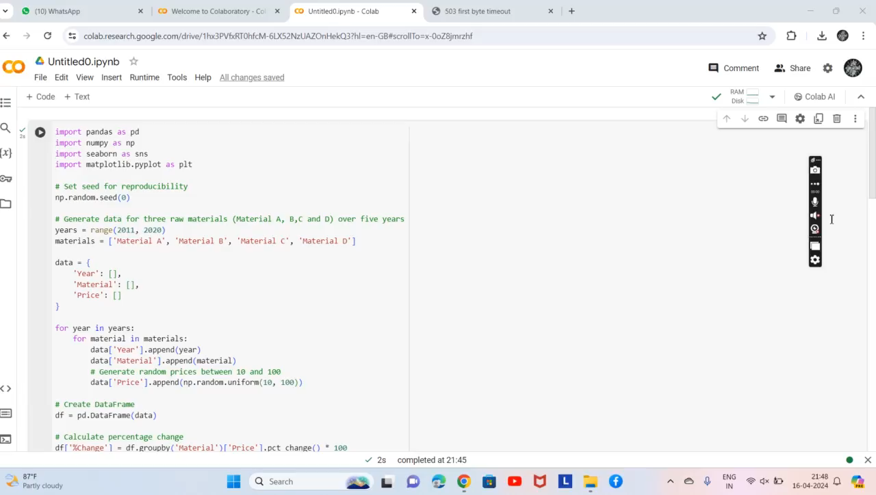
VIDEO OF THE PROJECT

Slide 14
conclusion
In conclusion, the analysis of agricultural raw material prices dataset through exploratory data analysis (EDA) has provided valuable insights into the dynamics of the agricultural market. By examining price fluctuations over the years, we were able to identify both high-range and low-range raw materials based on their prices. Furthermore, the assessment of percentage changes in prices highlighted materials with the highest and lowest percentage changes, offering additional perspectives on market trends. Additionally, the range of price changes observed over the years underscored the volatility and variability inherent in the agricultural sector, shedding light on the challenges and opportunities faced by stakeholders.

Slide 15
CONT..
The mapping of correlations between different raw materials using a heatmap visualization revealed potential interdependencies and relationships within the market, paving the way for a deeper understanding of market dynamics and trends. Overall, this analysis serves as a foundation for informed decision-making and strategic planning in the agricultural industry. By leveraging these insights, stakeholders can adapt their strategies, optimize resource allocation, and mitigate risks to navigate the complexities of the agricultural market effectively. Moving forward, further exploration and enhancement of analytical techniques and data sources will continue to drive innovation and value creation in the agricultural sector.

Slide 16
REFERENCES
https://towardsdatascience.com/heatmap-basics-with-pythons-seaborn-fb92ea280a6c
https://towardsdatascience.com/exploratory-data-analysis-8fc1cb20fd15
https://seaborn.pydata.org/introduction.html
https://machinelearningmastery.com/time-series-data-visualization-with-python/

Slide 17
THANK YOU

